Slide 1
Privacy at Risk: the Bill of Rights, the IV Amendment and the Case of Edward Snowden
Curator’s talk by William B. Warner
UCSB Library

Slide 2
What TIA censored: the All Seeing Eye
The word “total” became “terrorism”
The all-seeing eye in the pyramid
DARPA’s slogan: “scientia est potentia” = knowledge is power
Notice what’s in the center of the line of sight of the all- seeing eye

Slide 3
Total Information Awareness

Slide 4
Eric Snowden’s motivation
I don't want to live in a society that does these sort of things [surveillance on its citizens]... I do not want to live in a world where everything I do and say is recorded... My sole motive is to inform the public as to that which is done in their name and that which is done against them. ^{[171]}
For me, in terms of personal satisfaction, the mission’s already accomplished. I already won. As soon as the journalists were able to work, everything that I had been trying to do was validated. Because, remember, I didn’t want to change society. I wanted to give society a chance to determine if it should change itself. All I wanted was for the public to be able to have a say in how they are governed.^{[45]}

Slide 5
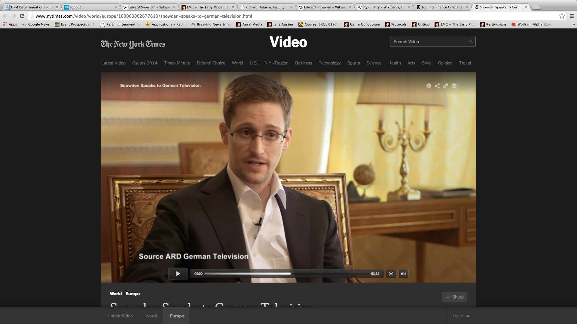
Edward Snowden makes his case

Slide 6
1: Video: Accepting the Sam Adams award given by retired intelligence officers on October 11, 2013 http://upload.wikimedia.org/wikipedia/commons/5/5a/Edward_Snowden_speaks_about_everything.webm
Seconds 0.26-2.03
2: Interview with film maker Speigel for German television that was reported in the NYTimes on January 29, 2014 Video From Snowden’s German TV InterviewBy ROBERT MACKEY
http://thelede.blogs.nytimes.com/2014/01/29/video-from-snowdens-german-tv-interview/?action=click&contentCollection=Politics&module=RelatedCoverage&region=Marginalia&pgtype=article
The TV interview clip of Speigel and Snowden:
http://nyti.ms/Laq73D
This clip makes the key point about popular consent of the government
3: The Guardian Christmas message from Edward Snowden
Edward Snowden warns about loss of privacy in Christmas message – video: warns of the surveillance now directed at your childen and compares it with Orwell’s 1984; makes key point that privacy is crucial to enabling us to consider who we are.
http://www.theguardian.com/world/video/2013/dec/25/edward-snowden-christmas-message-video

